Slide 1
CNS
East Zone
Rajarshi Mukherjee

Slide 2
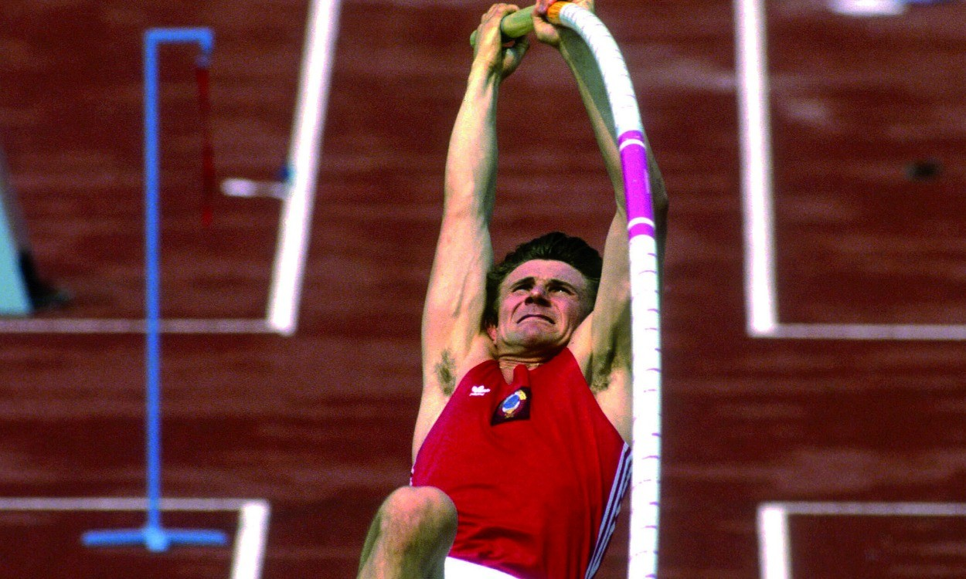

Slide 3
S E R G E I B U B K A
Set – Break – Reset Own Record of Excellence

Slide 4
Key Take Aways
SFE Parameters
Execution Excellence
In Clinic Competency
Growth Mindset

Slide 5
SFE Parameters
Call Average minimum 11
Coverage 100%
B / C Frequency minimum 95%

Slide 6
Execution Excellence
Proper tagging & execution of Campaigns
Input Utilization
Planning of Activities in time space of minimum 30 days
Documentation proceedings at least 10 days prior
Reporting accuracy

Slide 7
In Clinic Competency
Key Message Elements
Resolving Area of Concerns of KOLs
Objection Handling
Demand for the Business (DFTB) with Qty & Timeline

Slide 8
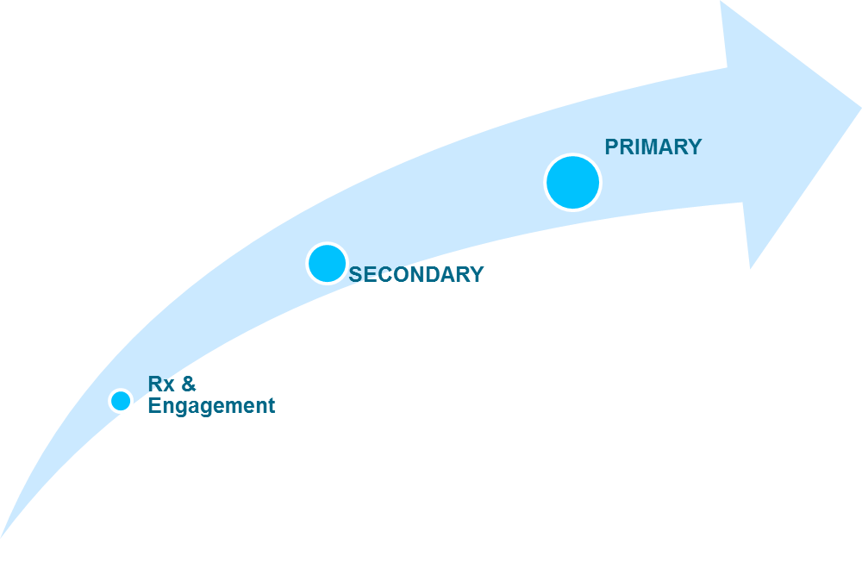
Growth Mindset
Business Uptake

Slide 9
Growth Mindset
Aricep :
Aricep Avg. PCPM – 1.20 Lakh
Aricep targeted PCPM by the end of Q3- 1.80 L
Key Actionable –
Arise Meeting to be conducted – Min 1 Activity /HQ in Q3
In-clinic Key Msg. Element – Driving the concept of BPSD
Aricep M- i. Targeting – 7 Rx/ Week from 5 - Prescriber
ii. Targeting 5 Non Prescriber for conversion (2 Rx) within next 12 day.( visit every 3-days in a week till starts prescribing)

Slide 10
Growth Mindset
Zonegran :
Zonegran Avg. PCPM – 0.20 Lakh
Zonegran targeted PCPM by the end of Q3- 0.70 lakh
Key Actionable –
Engage Meeting to be conducted – 1 Activity /HQ in Q3
In-clinic Key Msg. Element-Discussion of USP of Zonegran
Prescriber focus – i. 5 KOL / HCE
ii. 6 Rx/ KOL/ week
4. KOL Conversion – i. 5 KOL conversion/HCE ii. 2-prescriptions / month from Non prescribers by the end of October

Slide 11
Growth Mindset
Eprisan :
Eprisan Avg. PCPM – 0.15 L
Eprisan Targeted PCPM – Q3 - 0.50 L
Actionable :
Non Prescriber Focus : Target 2 KOL/ HCE (non prescriber of
Aricep & Zonegran)
Prescriber Focus : 5 Dr. / HCE visit weekly twice
( Orthos & Physician)
Morning OPD Campaign in OPD with high patient footfall
with Orthos, Physical medicine and Neuros

Slide 12
Growth Mindset
Merislon :
Merislon Avg. PCPM – 0.13 L
Merislon Targeted PCPM – Q3 - 0.50 L
Actionable :
Non Prescriber Focus : Target 2 KOL/ HCE (non prescriber of Aricep & Zonegran)
2. Prescriber Focus : 6 Dr. / HCE visit weekly twice
( Neuro / Physician)
Morning OPD Campaign

Slide 13
Commitment
2016-17 Final Lap as a Zone …..
East The Best

Slide 14
Thank You

